Slide 1
Implementation of Convolution using C++
Lab 3

Slide 2
C++ Support in CCS to work on DSK
The TMS320C6713 DSP Starter Kit (DSK) is a low-cost development platform designed to speed the development of high precision applications based on TI´s TMS320C6000 floating point DSP generation.
The kit uses USB communications for true plug-and-play functionality with innovative product designs with the DSK´s full featured Code Composer Studio™ IDE .
Code generation tools include an optimizing C/C++ compiler, an assembler, a linker, and assorted utilities.

Slide 3
Techniques to Implement Convolution
FIFO
Double Size FIFO
Circular Buffer
Double Circular Buffer

Slide 4
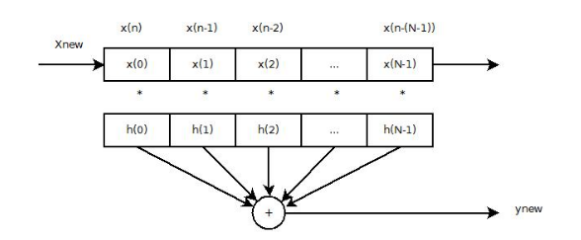
FIFO Buffer
We have covered code for FIFO in previous lab using Matlab.

Slide 5
Double FIFO
Using FIFO, buffer is shifted every time a new sample is received. This could lead to inefficient code.
One solution is to make a FIFO buffer that is twice as large as the data that is needed to store.
When this is done, shifting of the data can be done after a block of data is received.

Slide 6
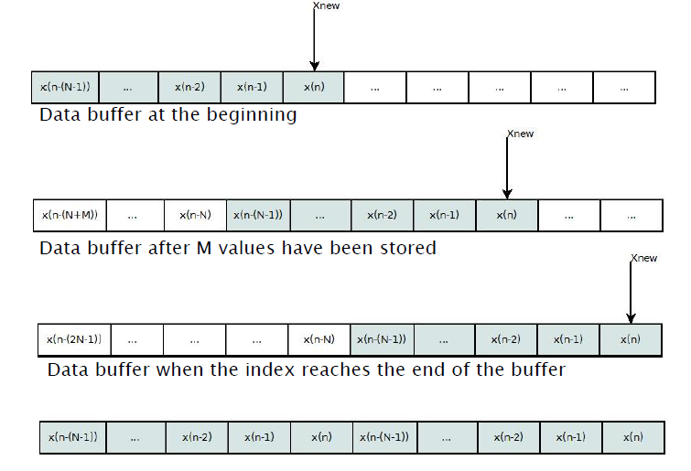
Double FIFO

Slide 7
Circular Buffer
The second method for storing input data is use a circular buffer.
To do this you will need to keep track of an index that tells where the last input was stored.

Slide 8
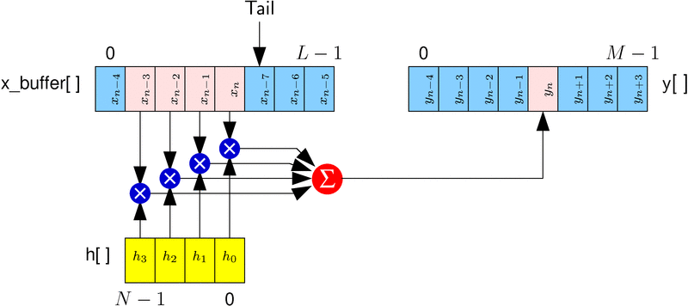
Circular Buffer

Slide 9
Pseudo Code for Circular Buffer
x[index] = input_sample // input data
ynew = 0;
for(k=0;k<N;k++)
{ if((index-k)<0)
{
ynew = ynew + h[k]*x[index-k+N];
}
else
{
ynew = ynew + h[k]*x[index-k];
} }
index = (index+1)%N;

Slide 10
Double Size Circular Buffer
In the previous implementation of the circular buffer notice that there is an if statement in the filter loop.
This is very time consuming.
So to remove this from the loop a buffer that is twice the length can be used. The new value that is received is put in two places within the buffer.

Slide 11
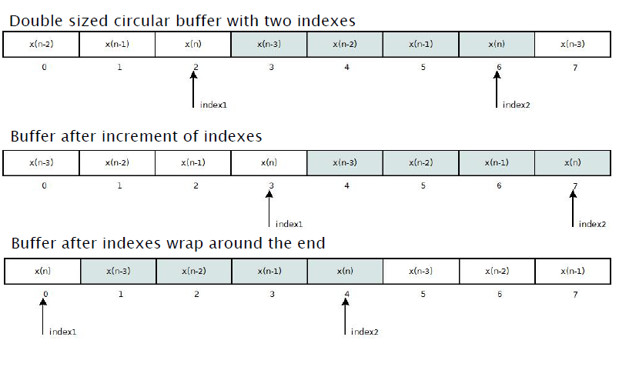
Double Size Circular Buffer

Slide 12
TASKS:
Write C++ code to implement following convolution techniques:
Double FIFO Buffer
Circular Buffer
Double Circular Buffer

